Slide 1
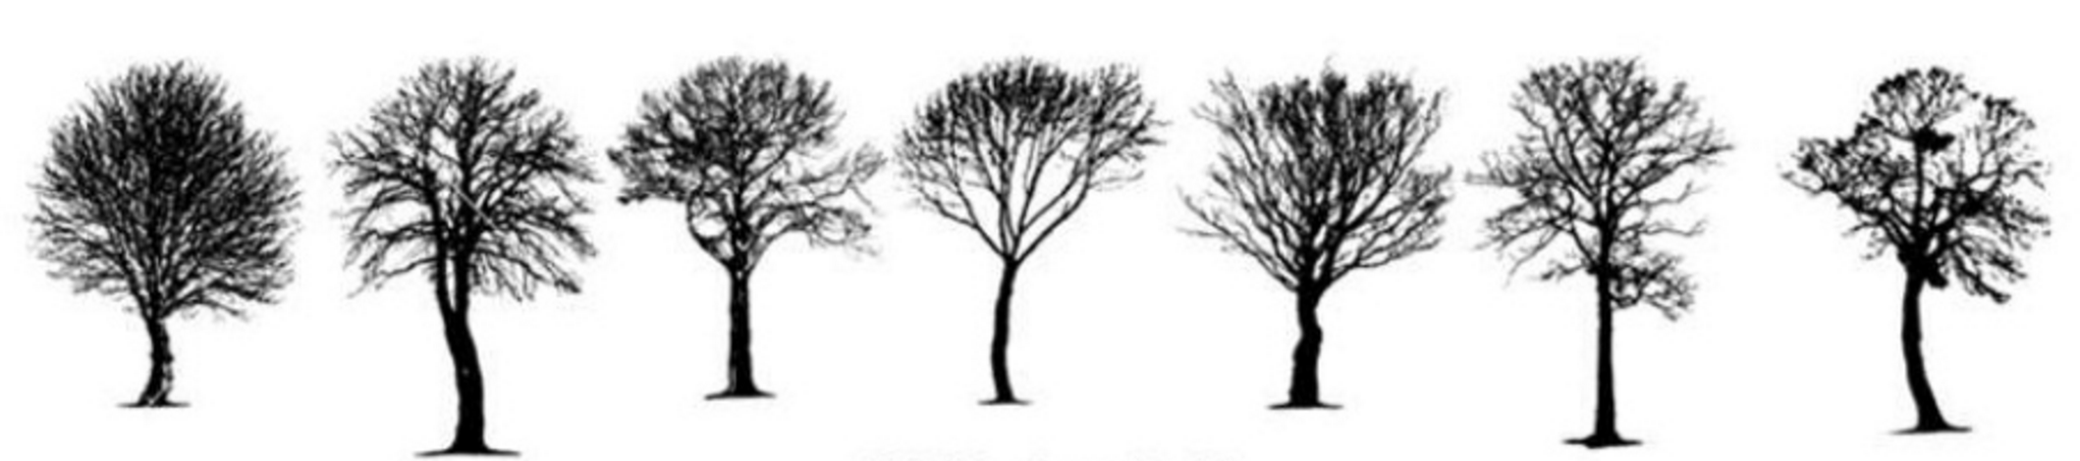
Stat 441 Presentation Past Kaggle Competition Forest Cover Type Prediction
Group 18
Yilun (Tom) Zhang
Yanbing (Miranda) Jin

Slide 2
Outline
Data and Problem
Exploratory Data Analysis
PCA and LDA
Supervised Learning Methods
Model Fitting
Parameter Optimization
Feature Creation & Feature Selection
Semi-supervised Learning Method

Slide 3
Data and Problem
Location: Roosevelt National Forest of northern Colorado
Data Source: US Geological Survey (USGS) and US Forest Service (USFS)
Training Set: 15,120 observations
Testing Set: 565,892 observations
Observation: 30m X 30m patch
Goal: predict the predominant kind of tree cover
30m
……
30m
……
……
……

Slide 4

Data and Problem
Predictors (12):
Numerical: elevation, aspect, slope, horizontal/vertical distance to hydrology, horizontal distance to road/wildfire ignition points, hillshade at 9AM-12PM-3PM
Indicator: wilderness area designation (4) and soil type (40)
Labels (7):
Spruce/Fir
Lodgepole Pine
Ponderose Pine
Cottonwood/Willow
Aspen
Douglas-fir
Krummholz

Slide 5
Exploratory Data Analysis – Distribution of Predictors
Histograms of all the numerical predictors
We might want to normalize and transform some of the variables so that they look normal

Slide 6
Exploratory Data Analysis – Scatter Plots Between Predictors
Selected scatterplots of Aspect vs. Elevation, colored by labels
Predictors can be significant when predicting the labels

Slide 7
Exploratory Data Analysis – Scatter Plots Between Predictors
Selected scatterplots of H_Dist_Fire_Points vs. H_Dist_Roadways, colored by labels

Slide 8
Exploratory Data Analysis – Relationship with Labels
Soil Types

Slide 9
Exploratory Data Analysis – Relationship with Labels
Wilderness
Types

Slide 10
Exploratory Data Analysis
Labels (Cover Type)
Balanced classes
Label | Count
1 | 2160
2 | 2160
3 | 2160
4 | 2160
5 | 2160
6 | 2160
7 | 2160

Slide 11
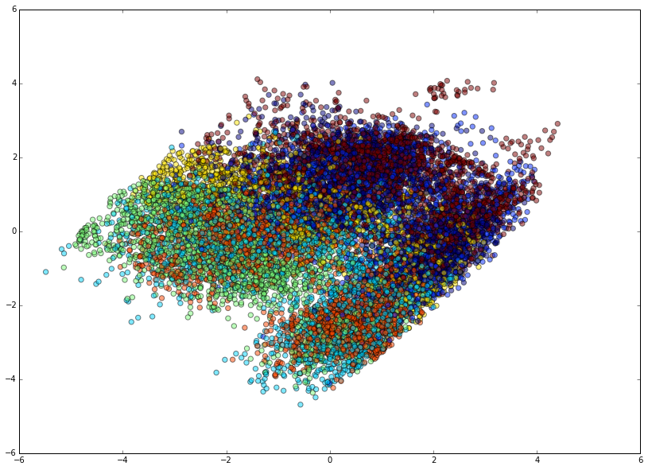
PCA – 2D
Without Transformation
With Transformation
94.76%
45.76%

Slide 12
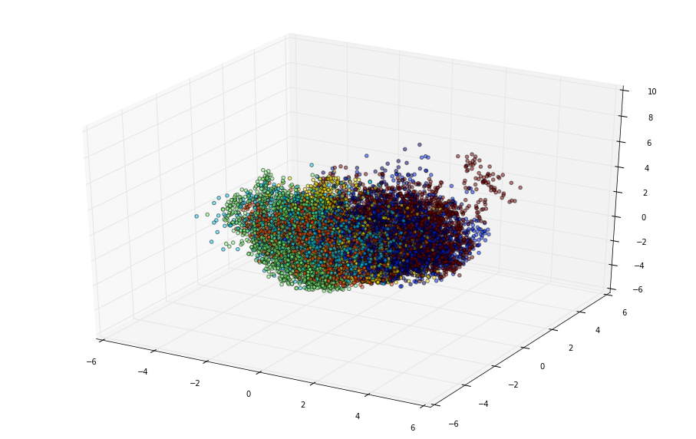
PCA – 3D
Without Transformation
With Transformation
98.35%
61.27%

Slide 13
LDA – 2D & 3D

Slide 14
Supervised Learning Methods
Multiclass Logistic Regression
Tree Methods
Decision Tree
Random Forest
Extremely Randomized Trees
Gradient Boosting (Trees)
SVM
Gaussian Naïve Bayes
Adaptive Boosting
Neural Network

Slide 15
Pros and Cons
Model Name | Pros | Cons
Logistic Regression | Fast, less prone to over-fitting Easy interpretation | When data is not linearly separable
Decision Tree | Fast | Might overfit the training data
Random Forest Extremely Randomized Trees | Robust to over-fitting, fast, takes categorical values | Interpretation
Gradient Boosting | Might overfit | Interpretation, much slower than RF
SVM | Can model complex non-linear relationship Robust to noise | Time, memory, tuning, interpretation
Gaussian Naïve Bayes | Less model complexity Requires less data | Assumes class conditional independence
Adaptive Boosting | Iteratively update weights on weak classifiers | Sensitive to noise data
Neural Network | Works good on data with non-linear relationship | Prone to over-fitting, time, interpretation Complexity, training data size

Slide 16
Analysis Flow
Feature Creation
Feature Selection
Unprocessed Data
Raw Data
EDA
Train Models
Processed Data
Centralize and normalize data
Best Model
Grid Search
Find the best parameters for random forest and gradient boosting

Slide 17
Model Error Rate with Default Parameters
Model | On Raw Data | On Transformed Data
Logistic Regression (LR) | 0.3227 | 0.3122
Decision Tree (DT) | 0.1991 | 0.1984
Random Forest (RF) | 0.1634 | 0.1614
Extremely Randomized Trees (ERT) | 0.1468 | 0.1521
Gradient Boosting (GB) | 0.1944 | 0.1948
SVM | 0.5390 | 0.3168
Gaussian Naïve Bayes (GNB) | 0.5324 | 0.5304
Adaptive Boosting (AB) | 0.5728 | 0.5727
Neural Network (NN) | 0.4008 | 0.3214

Slide 18
Grid Search - Parameters
Extremely Randomized Trees
Gradient Boosting
Parameter | Values
Number of estimators | [10,50,100,500,1000,2000,2500]
Minimum sample split | [2,3,4,5,10,20,30,40,50]
Split quality measure criterion | ["gini”,"entropy"]
Bootstrap sampling | [False, True]
Warm start (add more estimators to previous trees or generate a new one) | [False, True]
Parameter | Values
Number of estimators | [10,50,100,200,500,1000]
Minimum sample split | [2,3,4,5,10,20,30,40,50]
Learning rate | [0.1,0.2,0.3,0.4,0.5,0.6,0.7,0.8,0.9,1]

Slide 19
Grid Search – ERT
Parameter | False | True
Bootstrap | 0.1501 | 0.1726
Parameter | gini | entropy
Criterion | 0.1501 | 0.1448
Parameter | False | True
Warm Start | 0.1501 | 0.1501
Number of Estimator | Min Sample Split | Bootstrap | Criterion | Error
100 | 2 | False | gini | 0.1309
0.0159

Slide 20
Grid Search – GB
Number of Estimator | Min Sample Split | Learning Rate | Error
2000 | 3 | 0.3 | 0.1402
0.0542

Slide 21
Parameter Creation
OPTION 1
2-way interaction between all 10 numerical predictors (excluding Wilderness_AreaX and Soil_TypeX)
Elevation^2, Elevation*Aspect, Elevation*Slope, …, Hillshade_Noon*Hillshade_3pm
We now have 109 predictors
OPTION 2
3-way interaction between all 10 numerical predictors
Elevation^3, Elevation^2*Aspect, Elevation^2*Slope, …, Hillshade_3pm^3
We now have 329 predictors

Slide 22
Grid Search – ERT Interaction
2-way Interaction
3-way Interaction
Number of Estimator | Min Sample Split | Bootstrap | Criterion | Error
2000 | 2 | False | gini | 0.1124
0.0185
Number of Estimator | Min Sample Split | Bootstrap | Criterion | Error
100 | 4 | False | gini | 0.1230
0.0079

Slide 23
3-Way Interaction – Feature Importance
Select variables with importance > 0.0025
Total of 116 features
Test error: 0.1197
0.0033

Slide 24
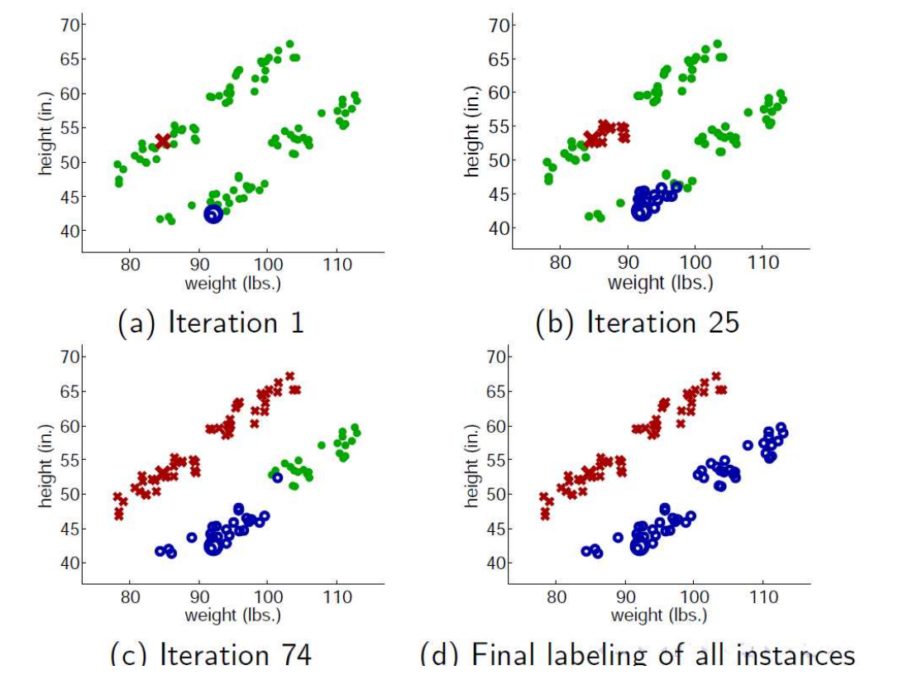
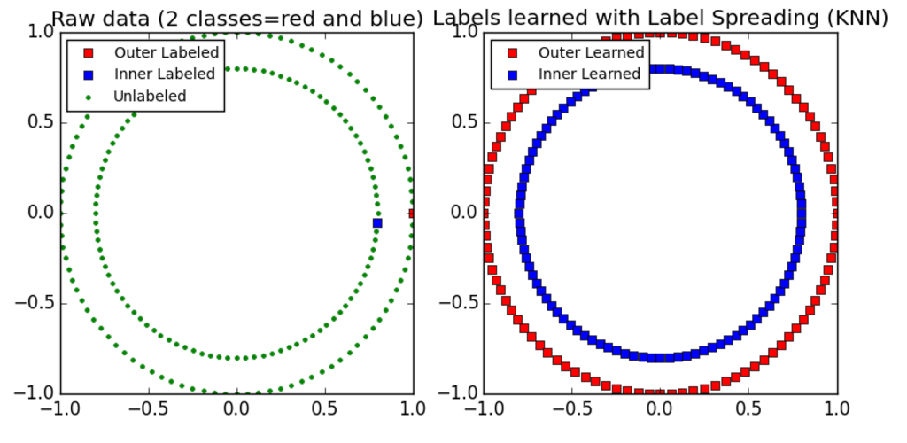
Semi-Supervised Learning Methods
Idea
Training set size 15,120; Testing set size 565,892
Borrow data from testing set
Better capture the shape of the underlying data distribution and generalize better to new samples

Slide 25
Distribution of Numerical Variables
Training Data
Testing Data

Slide 26
Semi-Supervised Learning Methods
Steps:
Borrow X% data from testing set randomly (set a random state)
Label Propagation / Label Spreading
Use the original training data + predicted labels as training set to train model
ERT for now
Predict on testing data
Also:
Change borrow rate (5%, 10%, 20%, etc.)
Fit other possible models
Use original data vs. data with interaction columns

Slide 27
Semi-Supervised Learning Methods
the similarity matrix to clamp the label distributions is different
Clamping allows the algorithm to change the weight of the true ground labeled data distribution to some degree (𝞪 level)
Hard clamping (𝞪 = 1), can be modified
Kernel: { RBF, KNN }
Label Propagation:
Uses raw similarity matrix constructed from data
Label Spreading:
Minimizes a loss function that has regularization properties (robust to noise)
On each iteration, it modifies the matrix and normalize the edge weights by calculating the normalized graph Laplacian matrix

Slide 28
Semi-Supervised Learning Methods
The label propagation / spreading algorithm changes the original label of the training data (~ 20%)
Change them back
Label Propagation
Label Spreading

Slide 29
Validation Result – Raw Data
Label Spreading method
KNN kernel only
Default ERT model with 1000 estimator
Label Propagation method
% Test Data Borrowed | Alpha | Testing Error
5% | 1.0 | 0.1865
5% | 0.8 | 0.1865
5% | 0.6 | 0.1889
10% | 1.0 | 0.1386
10% | 0.8 | 0.1534
10% | 0.6 | 0.1590
20% | 1.0 | 0.0959
20% | 0.8 | 0.1062
20% | 0.6 | 0.1101
% Test Data Borrowed | Alpha | Testing Error
5% | 1.0 | 0.1852
5% | 0.8 | 0.1909
5% | 0.6 | 0.2015
10% | 1.0 | 0.1403
10% | 0.8 | 0.1527
10% | 0.6 | 0.1692
20% | 1.0 | 0.0969
20% | 0.8 | 0.1058
20% | 0.6 | 0.1183

Slide 30
Kaggle Result
Model | Score | Rank (out of 1694)
ERT + raw data | 0.75793 | 591
GB + raw data | 0.72622 | 1074
ERT + 2-way interaction | 0.77803 | 368
ERT + 3-way interaction | 0.75972 | 540
ERT + 3-way interaction + best feature importance filter | 0.77985 | 362
Semi-Sup Label Spreading + raw data + borrow 20% + alpha 1.0 + ERT | 0.65952 | 1349
Semi-Sup Label Spreading + raw data + borrow 50% + alpha 1.0 + ERT | 0.73131 | 1022
Semi-Sup Label Spreading + 2-way interaction data + borrow 50% + alpha 1.0 + ERT | 0.73125 | 1022
Semi-Sup Label Spreading + 2-way interaction data + borrow 100% + alpha 1.0 + ERT | 0.77320 | 395

Slide 31
Thank you

